Slide 1
Driverless cars, AI and exams, robots that care – and future you
Webinar 2:
Driverless cars, AI and exams, robots that care – and future you
Prof Berry Billingsley
Dr Lee Hazeldine & Prof Berry Billingsley

Slide 2
Aims and Outcomes
Aims :
To examine the implications of AI in three case studies (marking test papers, driverless cars)
To understand an Epistemic Insight approach to International curriculum design
Outcomes: by the end of the session you will be able to:
Recognise the role of Epistemic Insight for addressing global big questions within the curriculum.
Identify the need for a global perspective in relation to the curriculum
Apply EI strategies to international issues within a cross-disciplinary curriculum

Slide 3
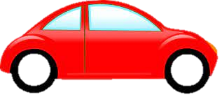
How can it be ‘driverless’?
What should we really call them?
Self-driving or autonomous or automated or remotely operated or hybrid or assisted
Can it be customised – colour, size, personality on the road or will cars become increasingly the same?
… your future – your choice.

Slide 4
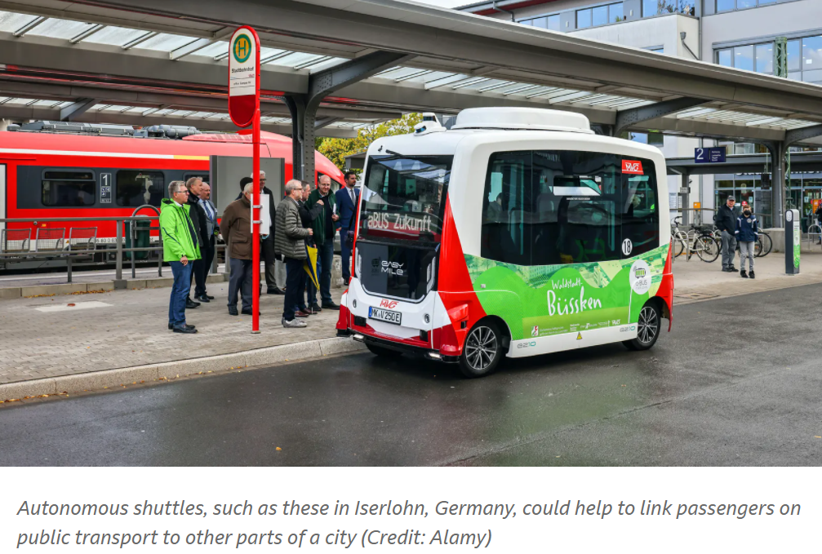
Autonomous shuttle

Slide 5
Responsibility – moral luck
justice versus consequence
Moral luck where a moral agent is assigned moral blame or praise for an action or its consequences even when they do not have full control over either the action or its consequences.
Thomas Nagel (1979) we seem to be committed to the general principle that we are morally assessable only for what is within our control - but, we morally assess agents for things that depend on factors that are not in their control.
Notes:
Thomas Nagel (1979) showed in their now classic pair of articles, it appears that our everyday judgments and practices commit us to the existence of moral luck. The problem of moral luck arises because we seem to be committed to the general principle that we are morally assessable only to the extent that what we are assessed for depends on factors under our control (call this the “Control Principle”). At the same time, when it comes to countless particular cases, we morally assess agents for things that depend on factors that are not in their control. And making the situation still more problematic is the fact that a very natural line of reasoning suggests that it is impossible to morally assess anyone for anything if we adhere to the Control Principle.

Slide 6
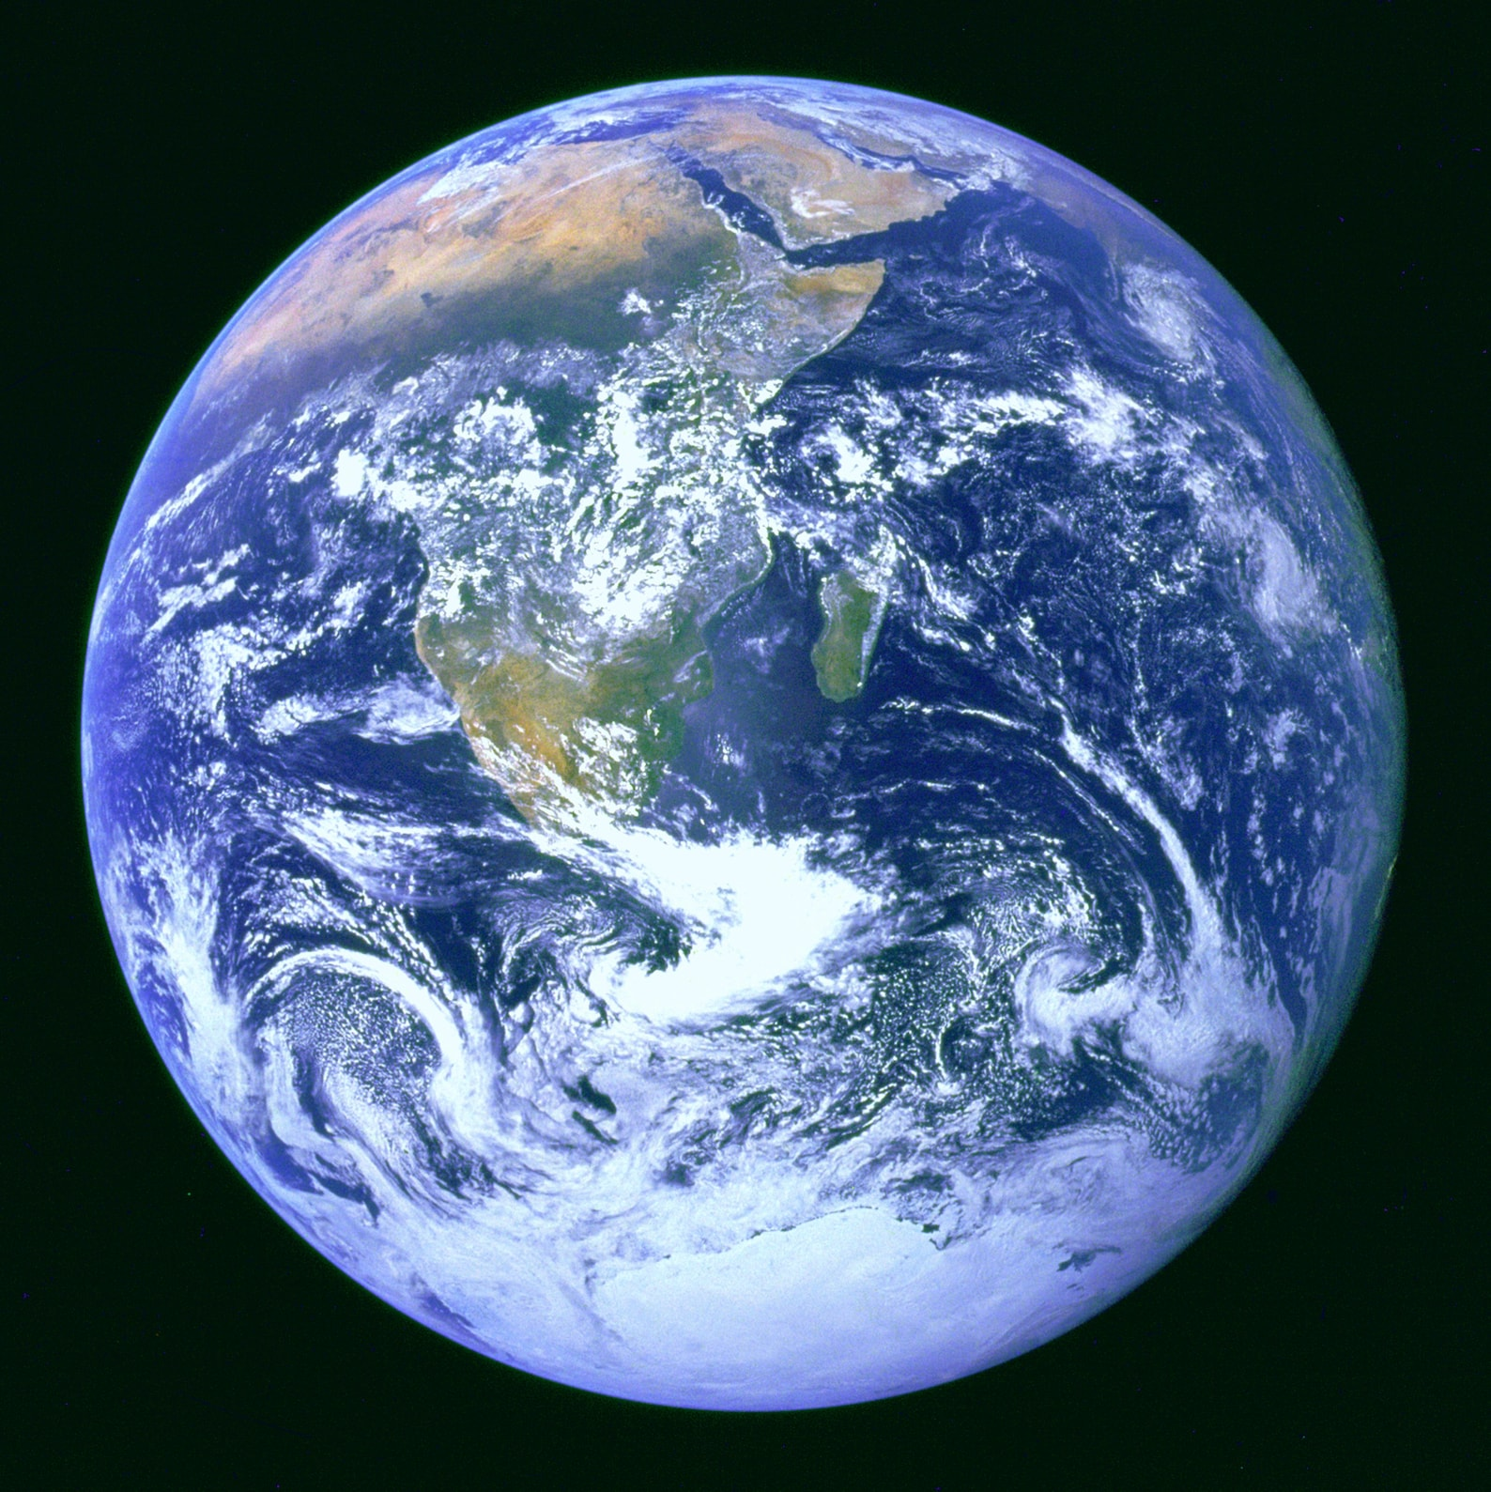
A Curriculum Dilemma
Schools are in a dilemma - and so too are education ministers and ITE tutors in teacher education.
For decades England has operated a national curriculum of discrete subjects - but if that continues then where and how should we teach 'cross-curricular' global themes and Big Questions?
And how can we link up competencies that operate across curriculum subjects (like critical thinking)

Slide 7
A Curriculum Dilemma
Examples of themes: Health Education, Citizenship, Sustainability …
Examples of competencies: critical thinking, digital literacy, collaboration …

Slide 8
An example: Health Education
Statutory guidance: Implementation of relationships education, relationships and sex education and health education 2020 to 2021
All of these subjects should be set in the context of a wider whole-school approach to supporting pupils to be safe, happy and prepared for life beyond school. For example, the curriculum on relationships and on sex should complement, and be supported by, the school’s wider policies on behaviour, inclusion, respect for equality and diversity, bullying and safeguarding (including handling of any reports pupils may make as a result of the subject content). The subjects will sit within the context of a school’s broader ethos and approach to developing pupils socially, morally, spiritually and culturally; and its pastoral care system. This is also the case for teaching about mental health within health education. The curriculum on health education should similarly complement, and be supported by, the school’s wider education on healthy lifestyles through physical education, food technology, science, sport, extra-curricular activity and school food.
https://www.gov.uk/government/publications/relationships-education-relationships-and-sex-education-rse-and-health-education/implementation-of-relationships-education-relationships-and-sex-education-and-health-education-2020-to-2021

Slide 9
An example: Health Education
Nineteen (out of 37 countries) countries/jurisdictions embed health literacy as a cross-curricular theme into existing subjects. In doing so, nearly all countries/jurisdictions, unsurprisingly, predominantly embedded physical/health literacy in the subject of physical education/health (e.g. in British Columbia [Canada] and Japan). In Portugal and the Russian Federation, science is the subject that carries most of the items related to physical/health literacy. In some countries/jurisdictions including Estonia, Northern Ireland (United Kingdom) and Kazakhstan, physical/health literacy is widely distributed across subjects.
OECD (2019), OECD Future of Education 2030. Making physical education dynamic and inclusive for 2030. International curriculum analysis, OECD Publishing, Paris, https://www.oecd.org/education/2030-project/contact/OECD_FUTURE_OF_EDUCATION_2030_MAKING_PHYSICAL_DYNAMIC_AND_INCLUSIVE_FOR_2030.pdf.

Slide 10
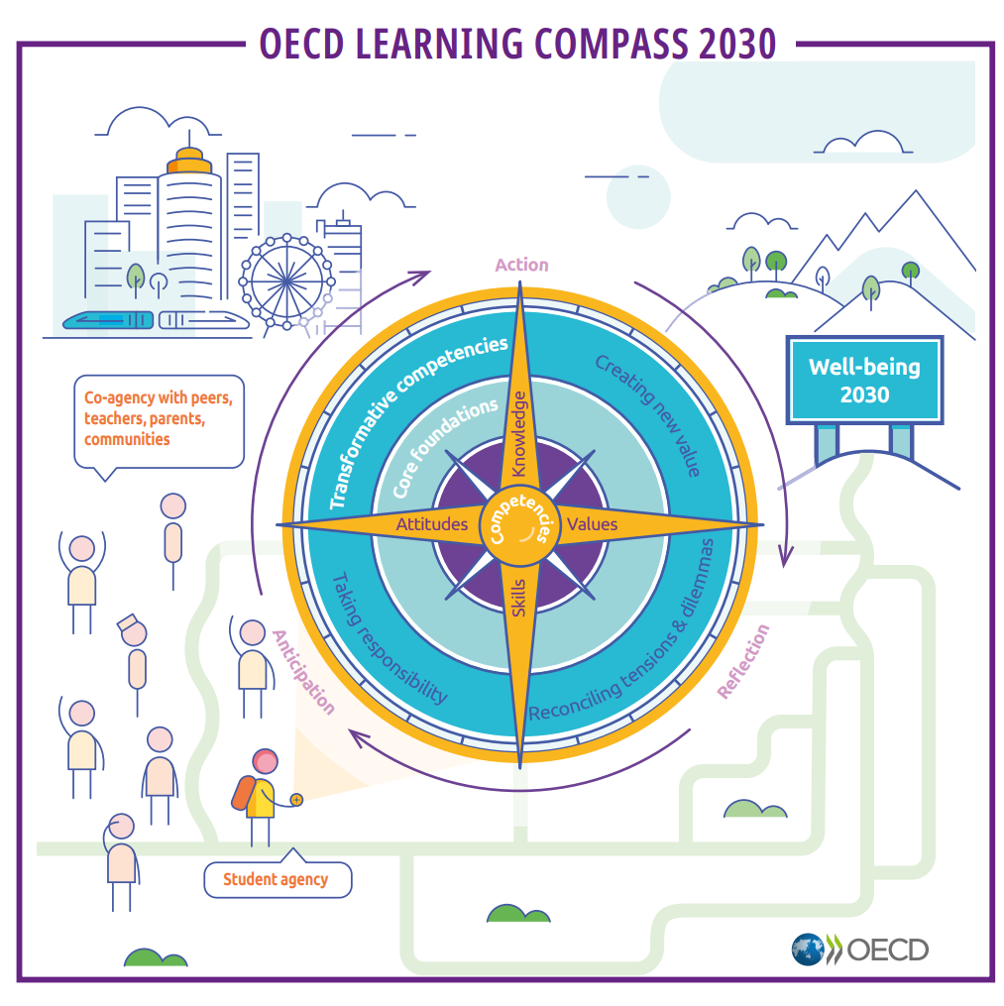
A Curriculum Dilemma
The OECD (Organisation for Economic Co-operation and Development ) sees incorporating global themes as a priority for curriculum design and highlights their prominence in its own curriculum policy document: the 'Education 2030 Learning Compass’.
It has produced an analysis and commentary on reforms by member countries so far. Speaking of the reforms made by member countries so far, the OECD says:
These themes also reflect the efforts of countries/jurisdictions to refresh their vision of education, echoing the Education 2030 Learning Compass. Some of the most frequent themes, including “environmental education, sustainability” and “local and global citizenship, peace”, reflect efforts to accommodate 21st century challenges in curricula through cross-curricular themes. Cross-curricular themes are also used to promote holistic development of students beyond traditional learning. This is articulated through cross-curricular themes like “health education, well-being, lifestyle” or through value-based themes like “moral/values education” or ”cultural identity and multiculturalism”.
https://www.oecd-ilibrary.org/sites/c4cff4cd-en/index.html?itemId=/content/component/c4cff4cd-en

Slide 11
A Curriculum Dilemma
A curriculum policy at a national level can only succeed if schools have the means, motivation and knowledge to meet them. And that is where the idea of practitioners, senior leaders and researchers co-creating a curriculum comes in.
Who is responsible for setting up the timetable and what happens when teachers are encouraged to collaborate to provide a holistic approach?
If traditional subjects like science test students' learning by asking them to recall knowledge in that subject - how if at all can teachers test children's answers to Big Questions that stretch across disciplines and provide them with formative feedback?

Slide 12
Case study- Ai marks exams …
On 31 March 2020, Gavin Williamson – secretary of state for education - issued a ministerial direction to the head of Ofqual, Sally Collier, to "ensure, as far as is possible, that qualification standards are maintained and the distribution of grades follows a similar profile to that in previous years". .
Then in August, 82% of 'A level' grades were computed using an algorithm devised by Ofqual. More than 4.6 million GCSEs in England – about 97% of the total – were assigned solely by the algorithm
The Ofqual algorithm worked with statistics for pupils' prior attainment and, importantly, the school or college's historic results.
.

Slide 13
Exams marked by AI – what went wrong?
thousands of students in England and Wales received A level grades that had been determined by an algorithm.
Statistics used in the algorithm include pupils' prior attainment and, importantly, the school or college's historic results.
Almost 40% of students received grades lower than they had anticipated, sparking public outcry and legal action.
Faced with protests, the UK government retracted the grades and students received grades based on their teacher’s estimate of what their grade would have been, had the exams gone forward as planned.

Slide 14
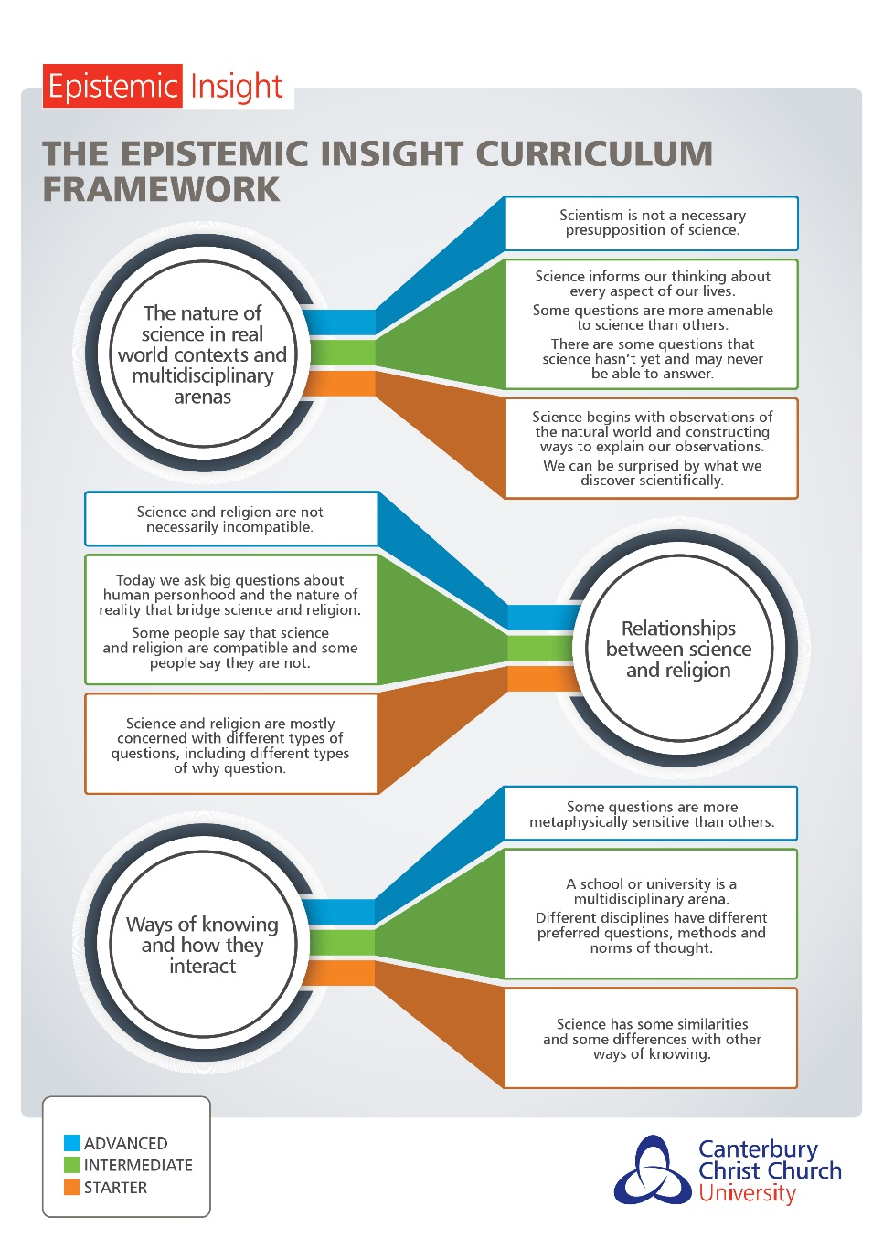
Critical thinking about AI– what do you think?
“We claim that the current AI ethics education space relies on a form of “exclusionary pedagogy,” where ethics is distilled for computational approaches, but there is no deeper epistemological engagement with other ways of knowing that would benefit ethical thinking or an acknowledgement of the limitations of uni-vocal computational thinking” (Raji, Scheuerman, Amironesei, 2021, pg.515)
“Those who approach computer science problems differently are pushed out of the field, resulting in more homogeneous mindsets and practices within the discipline and unsurprising diversity deficits” (Raji, Scheuerman, Amironesei, 2021, pg. 516)

Slide 15
Epistemic Insight & Big Questions
Big Questions are questions about the nature of reality and human personhood.
A Big Question cannot be adequately addressed through the lens of Science or History, or Philosophy or Geography or Religion etc. alone.

Slide 16
What is a discipline?
During the last webinar, we recognised that different disciplines produce different types of knowledge based on the questions, methods and norms of thought appropriate to them. For example, in Science:
Questions: A question that is amenable to science is one where we can test our ideas about the natural world by analysing observations and measurements.
Methods: Science involves gathering and analysing observations to test predictions
Norms of thought: A good answer in science has lots of evidence (observations) to support it and is reproducible by other researchers.

Slide 17
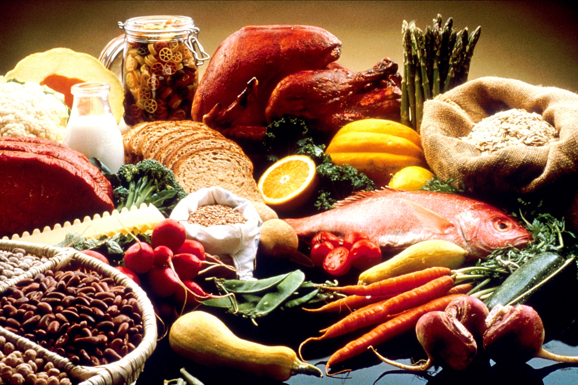
An example relating to Health
To use an example of a previous Big Question: 'Is it true that you are what you eat?’
An amenable question for Science would be: 'To what extent are the nutrients we eat important to sustain our existence?' (This can be measured, observed) and repeated.
Clearly, other types of questions relevant to our example Big Question are not amenable to science.
For example, 'how does food affect how we identify who we are?' is a question more amendable to the methods and norms of thought of history, psychology, geography or religious education etc.

Slide 18
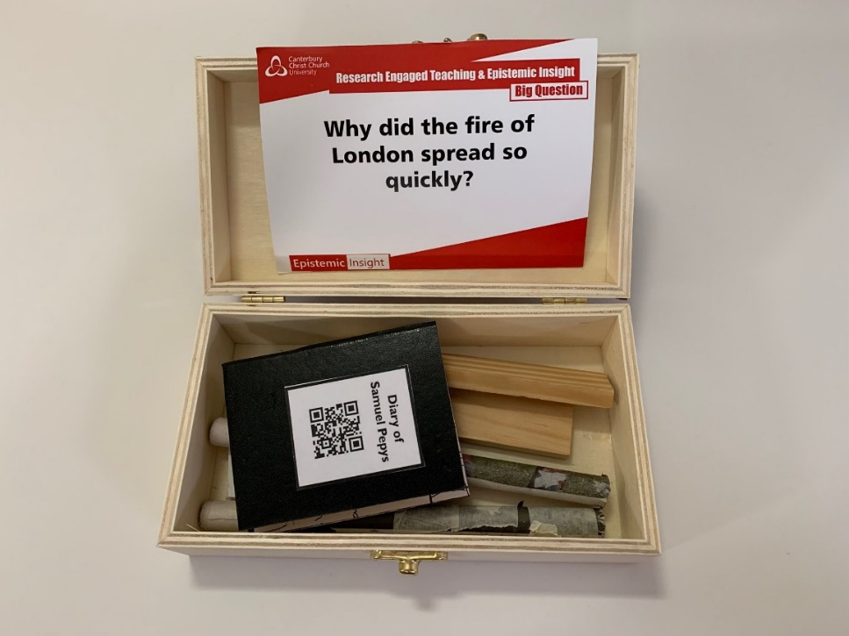
Health Education Activity
Can you think of a Big Question for Health Education?
What disciplines might be appropriate for approaching the question?
What strategy might you use? The Discipline Wheel, Discipline hats, Discovery Boxes….
https://cccu.padlet.org/lee_hazeldine2/z6x0v8zo3zhmjxsp

Slide 19
Driverless vehicles

Slide 20
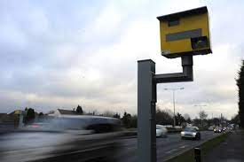
Going back to moral luck If an accident happens who is responsible?
In scenario 1 imagine you are keen to drive home and drive 40mph in a 30 but don’t get caught
Scenario 2, you are caught by a speed camera speeding
Scenario 3 You are in an accident and hit a pedestrian due to speeding
In the second scenario, the person gets a fine. In the second case there is a significant jail sentence possible. This is despite the fact the action is exactly the same.
Go back to the “driverless” helicopter. If there is an accident who is culpable

Slide 21
Robots – electronic personhood
“A growing number of areas of our daily lives are increasingly affected by robotics,”. In order to address this reality and to ensure that robots are and will remain in the service of humans, we urgently need to create a robust European legal framework”
.
https://www.theguardian.com/technology/2017/jan/12/give-robots-personhood-status-eu-committee-argues

Slide 22
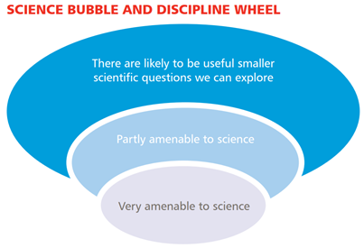
The voice of faith based organisations
EI seeks to develop epistemic tools to support educators and school children respond to big questions. By recognising the types of questions that are amenable to certain disciplines we can recognise the limitations of reverting to answers limited to an individual discipline.

