Slide 1
Session 10: Why do we need mathematical minds?
PFD4003 DEVELOPING MATHEMATICAL MINDS
NICOLA TIERNEY
Notes:
Copies of footprint
Discipline wheel
I am thinking like a scholar
5 minute lesson plan blank and exemplar

Slide 2
For this lecture you will need:
Pencil
Notebook
Coloured pens
Ruler
Compass
Glue stick
Preparation task work / notes

Slide 3
Why do we need mathematical minds?
SUCCESS CRITERIA
Know what is meant by Epistemic Insight.
Understand how maths can help answer questions alongside other disciplines.
Be able to articulate a question which maths can help solve.
Core Content Framework links:

Slide 4
Understanding the difference between curriculum content and curriculum intent
Mathematics is a creative and highly inter-connected discipline that has been developed over centuries, providing the solution to some of history’s most intriguing problems. It is essential to everyday life, critical to science, technology and engineering, and necessary for financial literacy and most forms of employment.
A high-quality mathematics education therefore provides a foundation for understanding the world, the ability to reason mathematically, an appreciation of the beauty and power of mathematics, and a sense of enjoyment and curiosity about the subject.
Notes:
The inspiration for this lecture is the phrase at the top. Purpose of study for maths is often far from minds when planning units and lessons.

Slide 5
Why mathematical minds are needed
The perils of innumeracy
Notes:
One rarely discussed consequence of innumeracy is its link with belief in pseudoscience. On one had we have genetic engineering, laser technology and microchip circuits, on the other tarot cards, crystals and mediums.
Erroneous perception of risk leads to unfounded and crippling anxiety or to impossible and economically paralysing demands for risk-free guarantees.

Slide 6
Knowing if the number makes sense
“100% chance of rain this weekend.”
Saturday
50%
Sunday
50%
Notes:
The mathematical equivalent of a double-negative in English. It doesn’t seem to inspire the same reaction however. What it means is that 50% of that area is expected to receive some rainfall at some point in that 24 hour period.
A 50 percent chance of rain means there is a 50 percent chance for any one spot in the forecast area to get wet during the forecast period. (Met Office)
50% (or half of our viewing area) will see some kind of wet weather. (US forecasts)
80% confident it will rain in 40% of the area, then a 50% chance of rain. (Precipitation probability)
Measurable precipitation 1/100”.
But on top of all those variables, is the plain fact that these are independent events. The chance of rain, however defined, is still only 50%,

Slide 7
Knowing if the numbers are in your favour
You can see a red side.
I’m offering even-money that it is the red-red card.
Is it a fair bet?
Notes:
3 cards, 1 is black on both sides, 1 is red on both sides, 1 is black one side and red the other. Cards are dropped into a hat and you are asked to pick one but only to look at one side – let’s say it’s red. You agree that it can’t possibly be the card that is black both sides and therefore is one of the two other cards. You are offered an even money bet that it is the red-red card. Is this a fair bet?
There are two ways I can win, but only 1 way you can win. It could be the red side of the red-black card (you win), one side of the red-red card (I win) or the other side of the red-red card (I win). My chances of winning are 2/3.

Slide 8
Knowing if the number is worrying
Test 98% accurate
If someone has the disease, the test is positive 98% of the time.
If they don’t have disease, the test is negative 98% of the time.
Assuming 0.5% of people actually have the disease.
You are given the test and told it’s positive.
How depressed should you be?
Cautiously optimistic.
Notes:
10 000 tests, on average 50 of the 10 000 people will have the disease. As the test is 98% accurate, 49 of those people will get a positive test result.
Of the 9,950 disease-free people, 2% will get a false-positive. That’s 199 false positives.
So out of 10 000 tests, there are 248 positive test results, of which 199 are false positives. That means the probability of having the disease is 49 / 248 which is just shy of 20%.
This is why we need to be careful when instituting mandatory or widespread testing for drugs or disease. Many tests are less than 98% reliable.

Slide 9
It’s the 24th March 2022. Write down the time.
Knowing how big numbers are
Write down by when, roughly, a million seconds will have passed.
Write down by when, roughly, a billion seconds will have passed.
Notes:
1000 000 = 11.5 days so approx. 9.30pm, 11.30pm on the 4th April or 2.30am on the 5th April.
1 000 000 000 = 32 years Around this day in 2054.
Neanderthal man disappeared about a trillion seconds ago (40 000 years ago).

Slide 10
Knowing if it is a big number
£350 million to be poured into extra childcare places.
UK public spending
£1 pp / per week
£3,562,000,000
(£3.562 billion)
£350 million ÷ 5 million families ÷ 52 weeks in a year = £1.35 extra per family per week.
Notes:
UK childcare is 3rd most expensive in the world.
£70 per family per year, £1.35 per family per week.

Slide 11
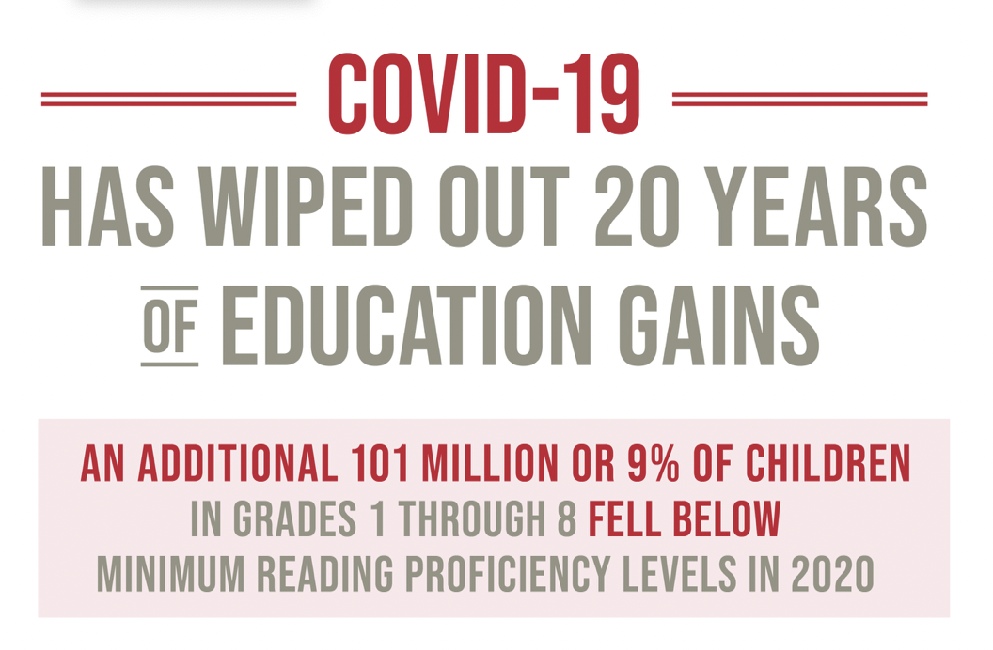
Knowing if these are big numbers
UN Sustainable Development Goals: https://sdgs.un.org/goals/goal4

Slide 12
Are those big numbers? Are they correct numbers? How confident are you?

Slide 13
Are they BIG numbers?
9% = 101 million children?
A 9% rise to 54% sounds less worrying.
Not on track to meet targets pre-Covid.
Geographically weighted.
Reversible by 2024.
UN Sustainable Development Goals: https://sdgs.un.org/goals/goal4
Notes:
6-13 year olds
101 million is 1.7% of the global population in 2000 and 1.3% of the current global population. For 9% to equal 101 million, the population of children alone would be over 10 billion. Or is it 101 million over 20 years? What do those numbers actually mean?
2000 children aged 0-14 30.158% global population of 6.114 billion
2020 25.482% global population of 7.762 billon
101 million children 1.7% of 6.114 billion, 1.3% of 7.762 billion
Even before COVID-19, the world was not on track to meet reading and mathematics targets. In 2019, only 59 per cent of children of grade three age were proficient in reading. The pandemic is projected to cause an additional 101 million children (roughly 9 per cent of those in primary and lower secondary school) to fall below the minimum reading proficiency threshold, increasing the total number of students falling behind to 584 million in 2020. This wipes out the progress achieved in education over the past 20 years. Similar declines are observed in the area of mathematics.
Nearly two thirds of the children falling behind live in Central and Southern Asia and Eastern and South-Eastern Asia. The proficiency rate was already very low in sub-Saharan Africa before the pandemic, so learning losses in this region would likely occur among children below the minimum level of proficiency. Recovery of the learning deficit globally could occur by 2024, but only if extraordinary efforts are made.

Slide 14
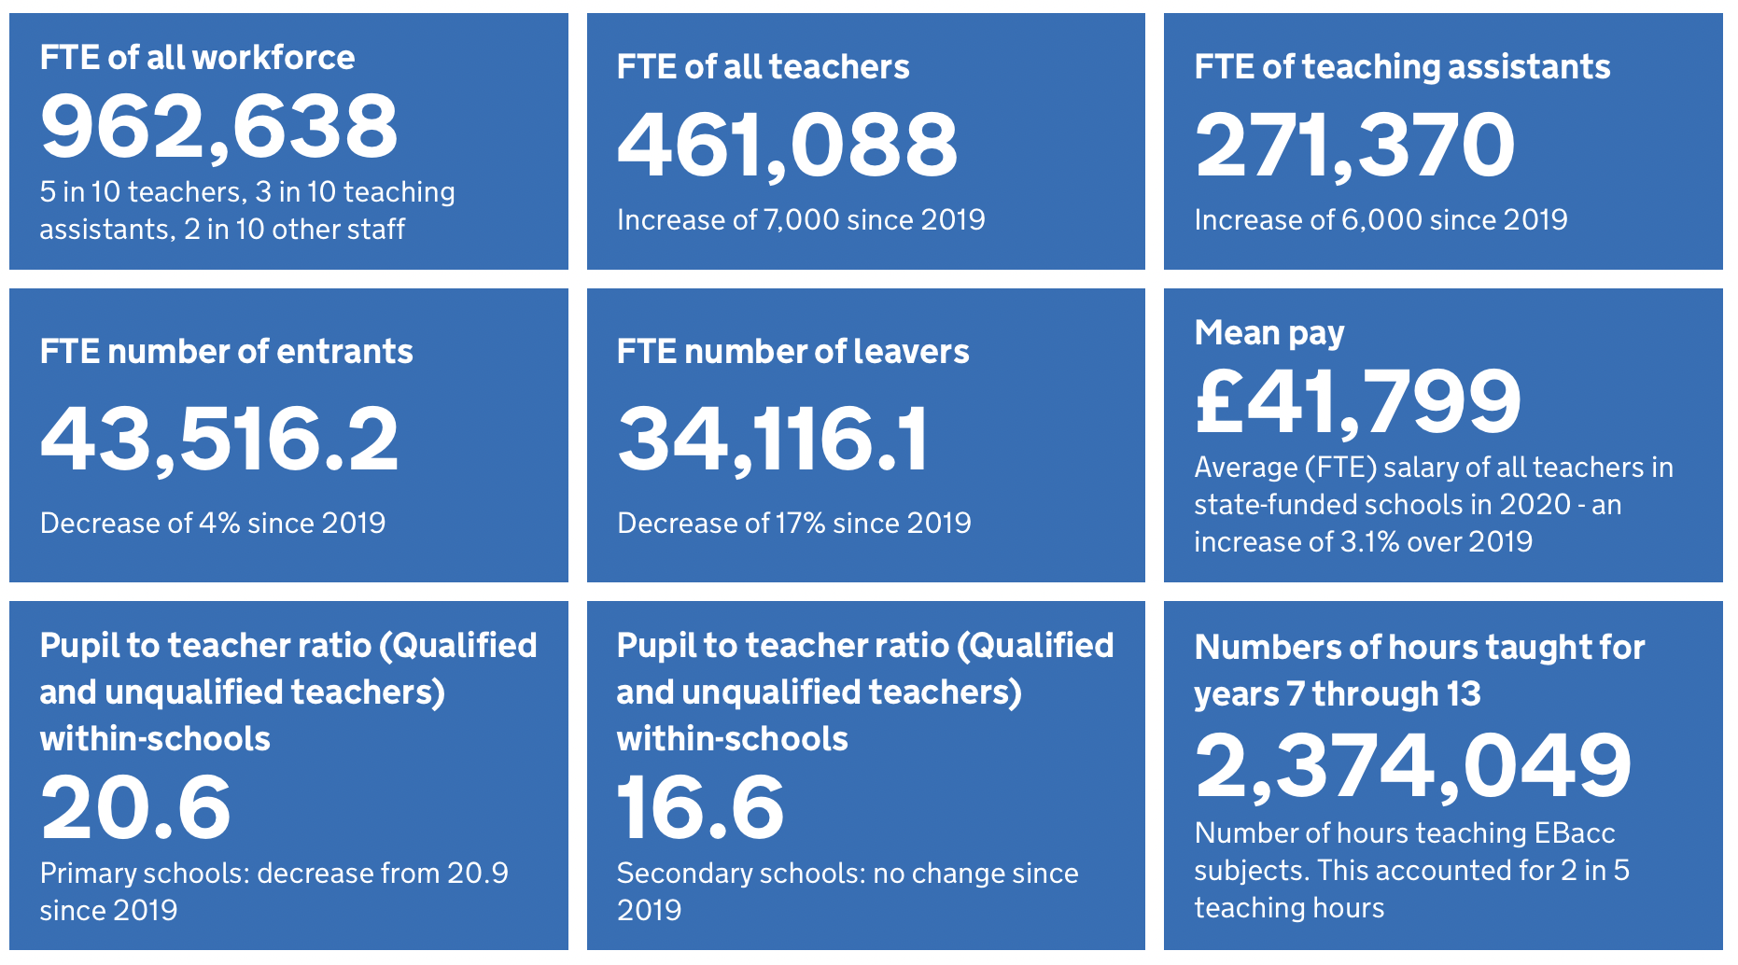
Knowing what the numbers refer to 2020 Headlines according to the DfE
https://explore-education-statistics.service.gov.uk/find-statistics/school-workforce-in-england
Notes:
The FTE of teachers has increased by 7,000 since last year.
Retirements from teaching continue to decline, likely due to increases in state pension age.
Retention of teachers one year after they qualify continues to decrease, however retention of teachers who qualified two or more years ago has increased; a change to previously seen trends.
Pupil to teacher ratios in nursery and primary schools has decreased due to more teachers and stabilising pupil numbers.
2 in 5 teaching hours were spent teaching English Baccalaureate (EBacc) subjects of mathematics, English, sciences (including computer science), history, geography and modern languages.
The number of temporarily filled teacher posts has decreased to levels comparable to 2012

Slide 15
Knowing what the numbers refer to £41,799 (mean salary)
Primary schools (LA, academy (converter & sponsor-led), free) | Mean | Median
Total | £39,913 | £38,633
Class teachers | £36,020 | £36,961
Male class teachers (no ldrshp) | £35,337 | £36,369
Female class teachers (no ldrshp) | £36,126 | £36,961
All teachers with leadership roles male | £60,963 | £58,135
All teachers with leadership roles female | £58,773 | £54,250
Headteachers male | £70,329 | £67,512
Headteachers female | £67,835 | £65,577

Slide 16
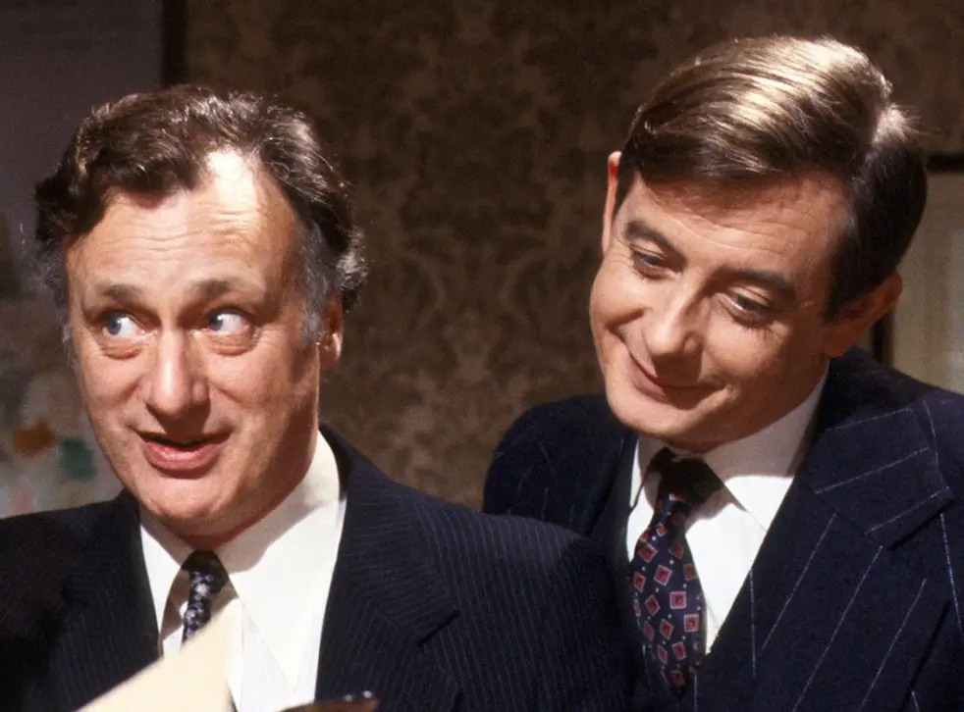
Asking if that’s what the numbers really mean
Read all about it!
Eating Cheese Leading Factor in Bedsheet Deaths!

Slide 17
“Statistics? You can prove anything with statistics.”
Correlation is not causation!
Notes:
Correlation not causation

Slide 18
Using online tools to update your world view.
https://www.gapminder.org/

Slide 19
What is Epistemic Insight?
‘Gaining epistemic insight is about developing an appreciation of the strengths and limitations of individual disciplines.’ (LASAR, 2021)

Slide 20
Asking questions
Some questions are more difficult to answer than others. We call these questions big questions.
What does it mean to be alive?
Why does life on Earth exist?
What is human personhood?
Disciplinary questions
Bridging questions
(LASAR, 2021)
Notes:
Disciplinary questions can be answered by one discipline alone.
Bridging questions can be answered by two or more disciplines.
Epistemic insight helps you articulate which questions are disciplinary and the role of each discipline in bridging and big questions.

Slide 21
Can maths answer these questions?
How do you know that plants photosynthesise?
How do I know you have a toothache?
How do you know that I am in love?
How do you know the sun will rise tomorrow?
How is the SARS-CoV-2 virus transmitted?
How do we know global warming is causing climate change?
Maths alone?
Informed by maths?
Better answered by other disciplines?
Notes:
Sort and generate activity – add another question to each group. Flipchart Venn and post-its.

Slide 22
How is tea made?
The mathematics of tea making
The science of tea making
The art of tea making
Tea making around the world
…
How is tea made?

Slide 23
What does it mean to think like a mathematician?
Notes:
Vevox poll – word cloud

Slide 24
Some thoughts…
Pattern-seeking
Systematic
Define, classify
Consideration of all factors, emphasising and ignoring
Trying examples, looking for rules
Creative
Modelling
Setting levels of accuracy
Recognising the definite and the messy
Looking for efficiency and ease

Slide 25
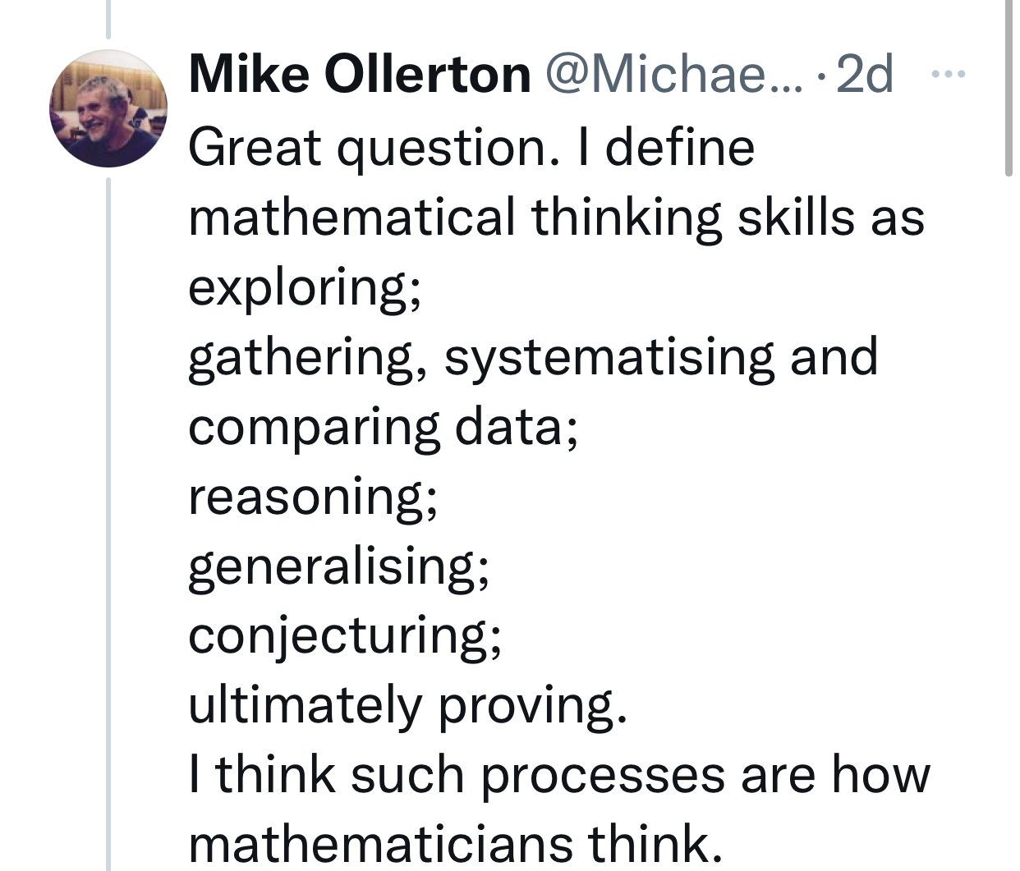
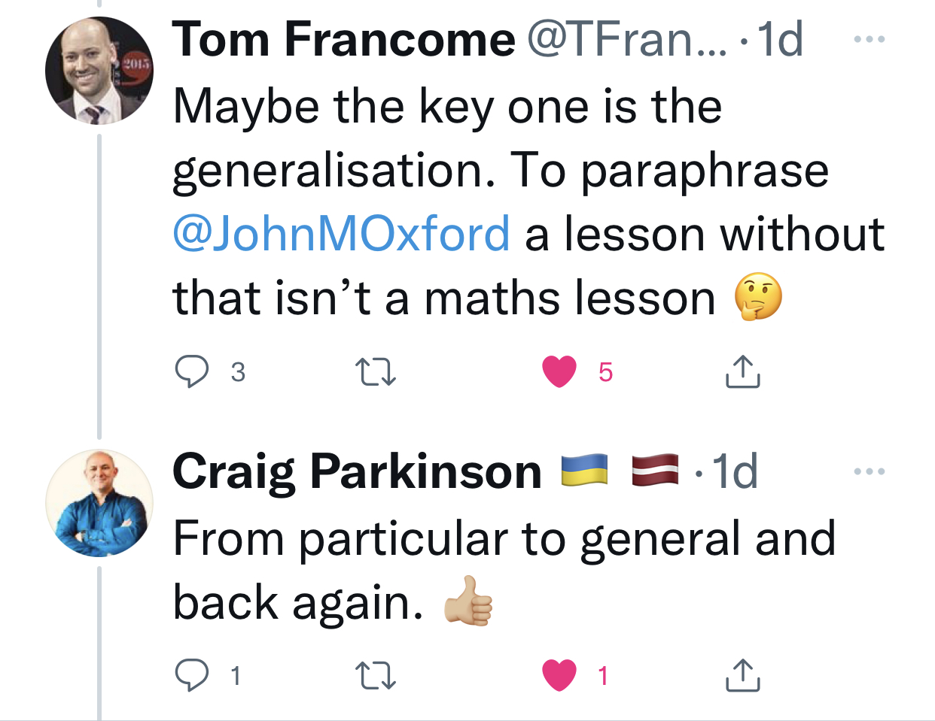
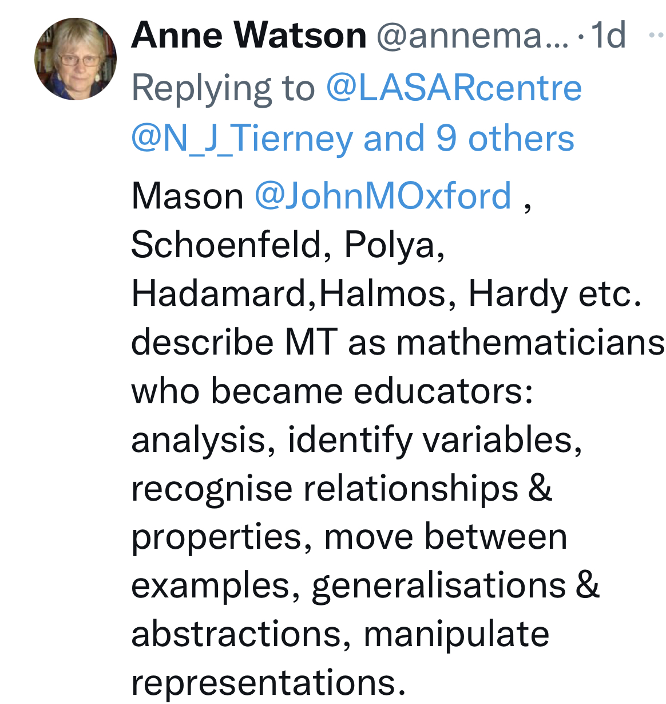
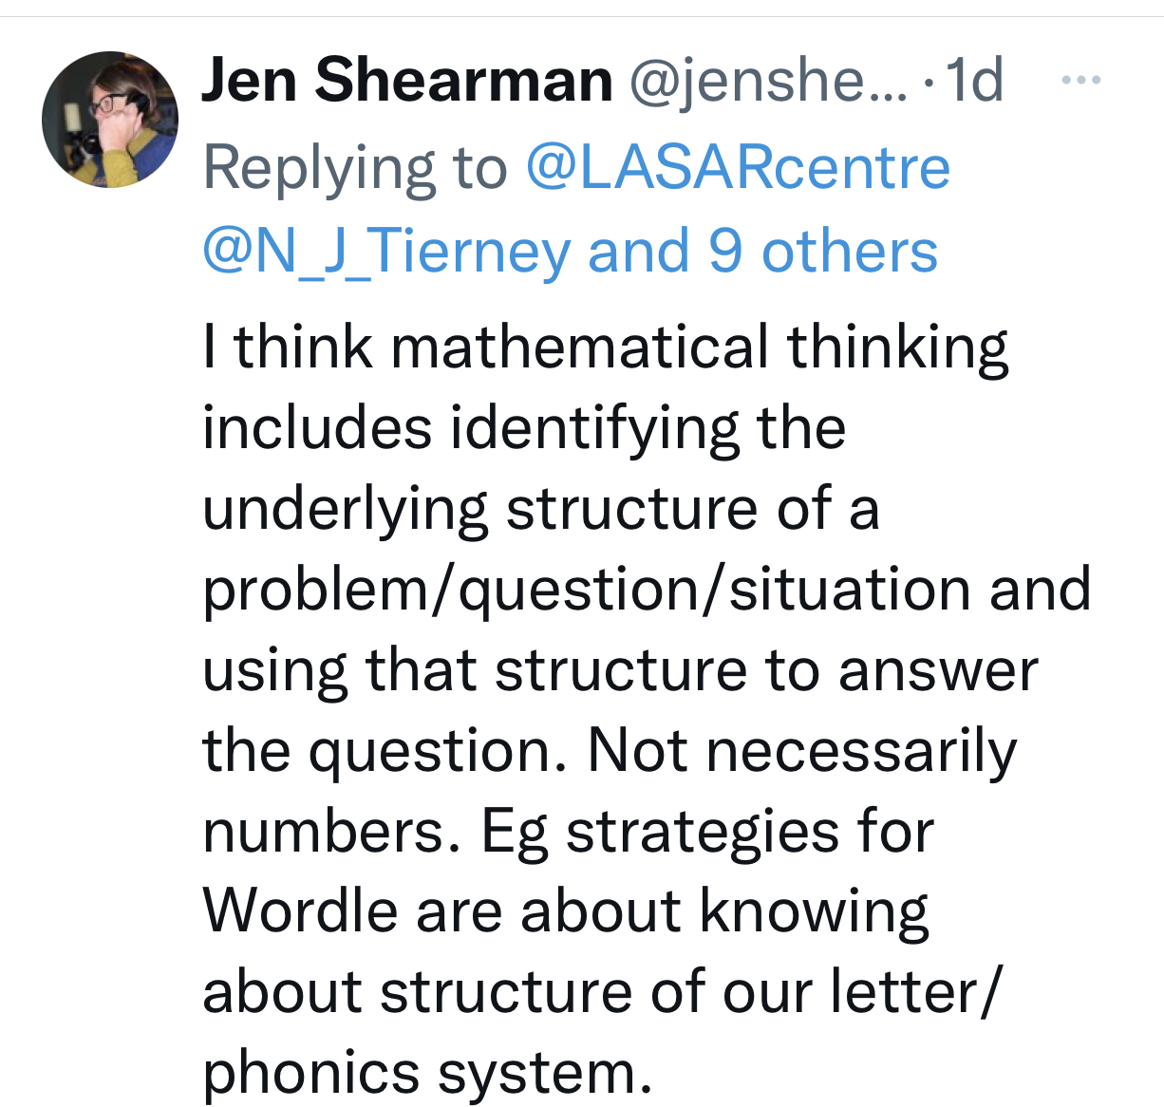
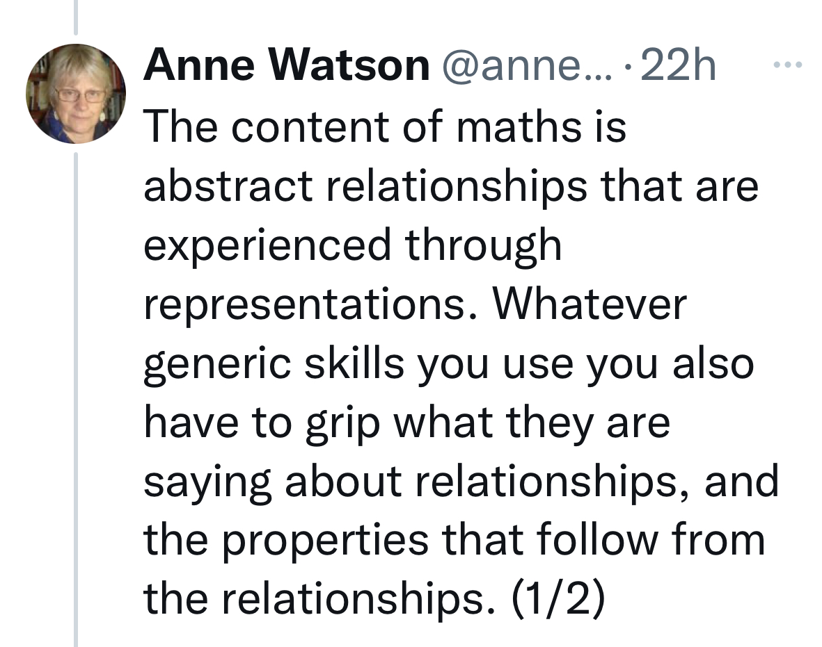
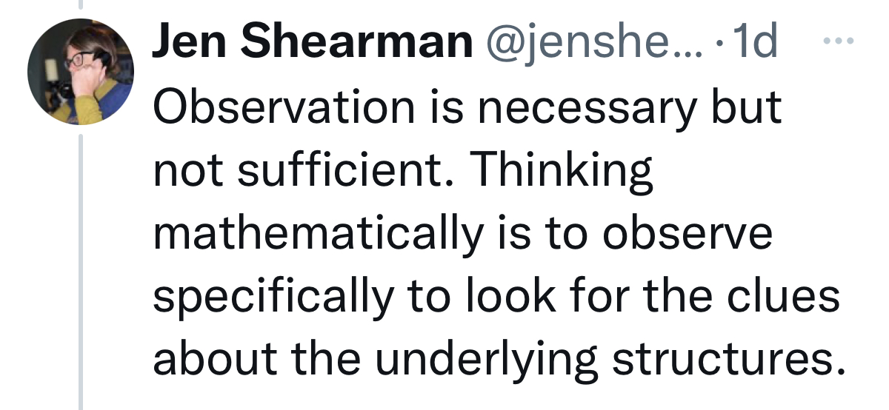
What does it mean to be a Mathematician? Comments from Twitter.

Slide 26
Ways of Thinking
How do we make a perfect cup of coffee?
How does mathematics / English / science understand this question?
How does mathematics / English / science investigate this question?
How would mathematics / English / science know if it has a good answer?
How can I make a better answer?
(LASAR, 2021)
Notes:
How does mathematics understand this question? (Questions)
How does mathematics investigate questions? (Methods)
How would mathematics know if it has a good answer? (Norms of thought)
How can I make a better answer?

Slide 27
Ideas to take away with you

Slide 28
What is a footprint?
Being able to sort out which information found online is relevant, we need an implicit understanding of the strengths and limitations of different disciplines and the types of question, method and norms of thought which shape different disciplinary responses.
(LASAR, 2021)

Slide 29
Directed follow-up task
Read Ch 11 ‘Your relationship with mathematics’ (Jackson, 2015).
Submit your reflection log by Thursday 21st April.

Slide 30
Lecture reference list
Blastland, M. & Dilnot, A. (2008) The Tiger That Isn’t: Seeing through a world of numbers. London: Profile Books.
LASAR (2021) 'A guidebook to building an epistemically insightful learning experience in primary schools' LASAR at Canterbury Christ Church University [Teaching resource]. Canterbury Christ Church University.
LASAR & Willington Grammar School for Girls (2021) 'Epistemic Insight' LASAR at Canterbury Christ Church University [Teaching resource]. Canterbury Christ Church University.
Paulos, J. A. (1989) Innumeracy. London: Viking.

