Slide 1
big questions; and their ability to plan across a number of different subjects?
LO Explore an example big question and identify the range of subjects that inform an answer.

Slide 2
Introducing big questions
Some questions are more difficult to answer than others. We call these questions big questions.
Examples include:
What does it mean to be alive?
Why does life on Earth exist?
What is human personhood?
Equally some questions can be answered by one discipline alone, we call these disciplinary questions, some can be answered by two disciplines, we call these bridging questions. Epistemic insight helps you articulate which questions are disciplinary and the role of each discipline in bridging and big questions
.

Slide 3
Becoming more scholarly
Below are some examples of what teaching epistemic insight might look like and reasons to help students become epistemically insightful.
Thinking like a scholar KS1 In school we begin by understanding how to think like a theologian or a scientist. Introducing disciplinary questions is helpful.
In KS2 we can introduce bridging questions. In lower KS2 students can identify which disciplines can inform an answer. By upper KS2 we can encourage children to construct their own investigations and identify the distinctive role each discipline plays

Slide 4
Which of these questions can be answered by only one discipline?
1. How do you know that animals respire?
2. How do I know you have a toothache?
3. How do you know that I am in love?
4. How do you know the sun will rise tomorrow?
Should wearing masks in public spaces be made mandatory?
How do we know global warming is causing climate change?
One discipline alone- which one?
Bridging question?- which ones
Big question?
Notes:
Add discussion points here. We spent a lot of time looking at question 9. There was discusion on whether this required a level of historical, mathematical and geographical knowledge. I.e. reading graphs refering back to previous fluctuations in global temperatures.
Some here are easier to group than others, but I think that is the point of the debate.
Important to say that answers to Q 7and 8 is not mere opinion. Depending on the lens you have you may have very different answers to these questions.
In terms of research articulate that in primary school teachers are skilled at blending a range of disciplines. However now with a science teacher lens we need to appreciate the types of questions which are investgiative by scientific enquiry. Our research is interested in unpacking the distinctiveness of scientific knowledge, and how it blends with other disciplines to construct a holistic curriculum. Further it aims to promote an understanding of comparing the merits of distinct disciplines in answering questions and how to relate science to big questions.

Slide 5
Appreciating the distinctiveness of an individual discipline.
Questions
Questions which investigate the nature of the world around us
Methods
Hypothesis
Observation
Data collection
Analysis
Proof/evidence
Ways of thinking
Objectivity
Replicability
Consensus

Slide 6
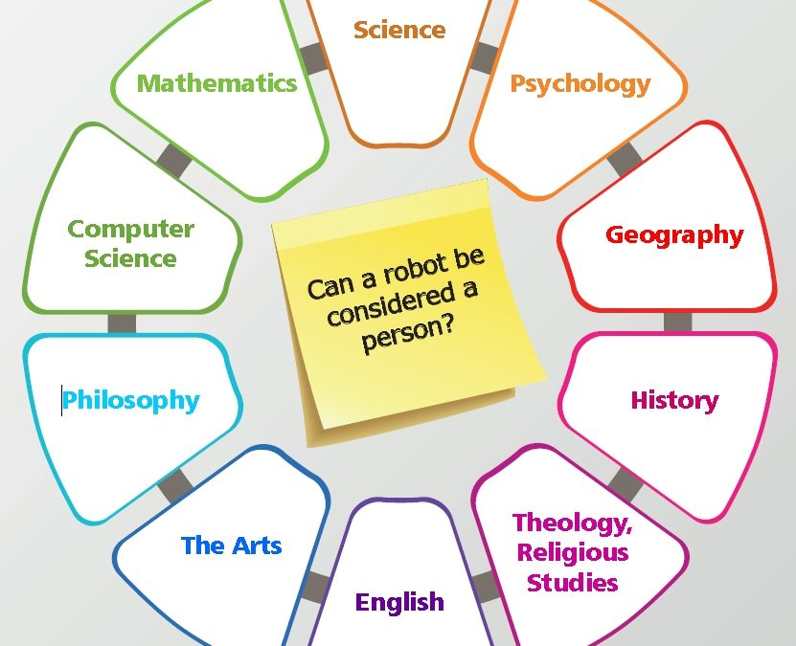
How do we seek to solve big questions? The discipline wheel
We Can use the discipline wheel to identify which subjects inform a complete answer to our big questions. This will not always be static so once you and your students develop confidence with this, you can introduce a blank discipline wheel and get your students to work out which disciplines are relevant.
Notes:
The idea here is that there can be a multitude of disciplines that can inform big questions that look at real world problems. Our research is interested in how we support trainee teachers appraciate the types of questions that are purely scientific and how the distinct lens through which you view a question informs the answer that is given.
Take the example of why did the titanic sink useful clip hear if you have time. Epistemic insight watch from 1 minute stop at around 3 minutes Epistemic insight: engaging with life's Big Questions | Berry Billingsley | TEDxFolkestone - YouTube

Slide 7
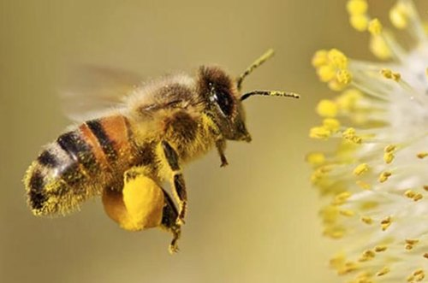
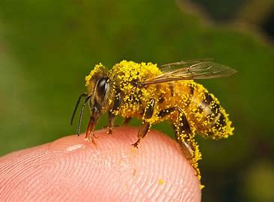
A new big question
Even if I don’t like honey, should I care if the honeybees die out?

Slide 8
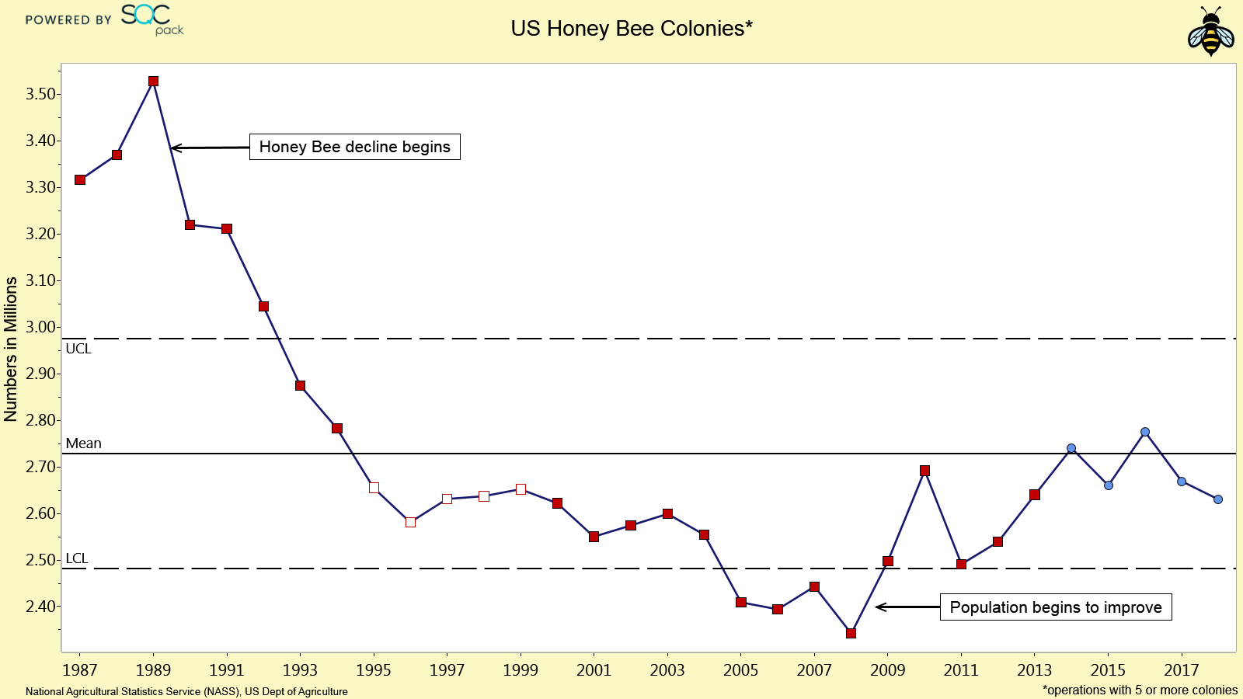
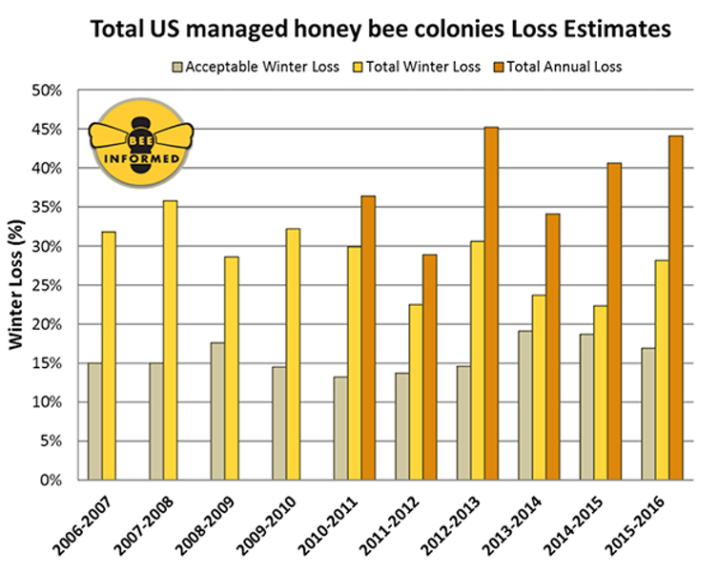
Graphs on honey bee population a mathematical lens?

Slide 9
Bees in the news
Cockburn, (2021)

Slide 10
Big questions linked to real world problems: Sustainability. UN SDGs
UNESCO (no date)

Slide 11
Task
On the link below you have access to a blank discipline wheel. This is also available on Moodle to download
Use the selected KS2 national curriculum statements from each subject to choose: Which subjects you would include in your discipline wheel and why.
https://livesmucac.sharepoint.com/:f:/s/EpistemicInsightsProject/Eqdq3vVlPBpLhNDzR5n4BDIB9wsgjHDdxL-6zAkXVSwePw?e=aGUYO6

Slide 12
English LKS2

Slide 13
Maths LKS2

Slide 14
Science LKS2

Slide 15
Science cont.

Slide 16
Music

Slide 17
Computing

Slide 18
DT KS2

Slide 19
Art and cooking

Slide 20
Geography

Slide 21
Geography

Slide 22
History

Slide 23
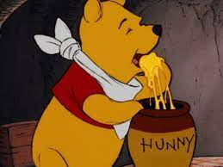
Task 2 Use the following prompts to identify the resources you would use to answer your big question
Hampton court palace built in 1514 – change in diet over time (possible primary school trip)
Kew Gardens.
National archives at Kew
Bushey Park
Richmond park
Flight of the Bumblebee by the Russian composer Nikolai Rimsky-Korsakov
Use the following link to plan your activity. https://docs.google.com/document/d/1IzmRj5EqwBKDQAKRupkLnStUvOvtJlYWkCgZ1SOWRCE/edit?usp=sharing

Slide 24
Plenary task
Share your plans with another group. You will need a link to do this.
Paste your link in the chat.
Peer review the tasks
WWW
EBI
Notes:
Give links for each group based on google docs they have come up with.

