Slide 1
LLM in International Business Law at St Mary’s University, Twickenham
What will you learn?
Where is it?
How does it look like?

Slide 2
Where is it?
How does the campus look?

Slide 3
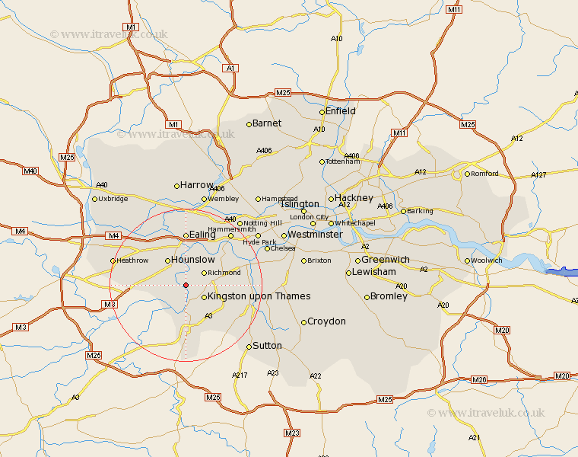

Slide 4
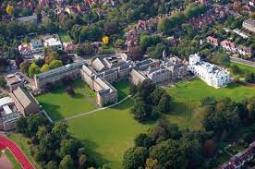
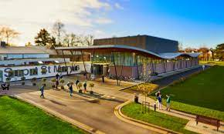
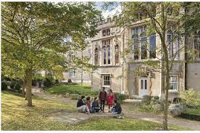

Slide 5
Anush Ganesh
LLM Program Lead in International Business Law
Teaching- Competition Law, Insurance Law, Monetary Laws, Investment Law, Economic and Business Laws, Digital Market Regulation, and IP and Competition
Education- BA.LLB (O.P JGU, India), LLM (UEA, England), PhD (UEA, England)

Slide 6
Anush Ganesh
Main Research
the application of competition law to zero-price online platforms
the assessment of predatory pricing in two-sided platform markets
the law and economics of price personalization
effective remedies in digital market abuse of dominance cases.
Publications
Anush Ganesh, 'Predatory Pricing in platform markets: A modified test for firms within the scope of Article 3 of the DMA’ CCP Working Paper Series 23-02.

Slide 7
Which modules do we teach?

Slide 8
International Economic and Business Laws
Understand International Monetary Laws and discuss the role of the IMF and World Bank
Understand international investment laws
International Competition Law
Rules of expropriation
Role of sustainability and human rights in International Business
State Sovereignty and liberalisation
Debt crisis

Slide 9
International Trade Law
develop your critical and analytical skills in considering the complexities and ethics of the law and policy of the World Trade Organization
familiarise yourself with WTO dispute settlement procedures to enable you to produce a case study critical analysis
develop your commercial awareness of current and topical issues in international trade
enhance your transferable skills of presentation and communication in the context of oral and written assessments on international trade law.

Slide 10
EU Competition Law with a Global Context
The course will have an in depth discussion of the 3 pillars of competition :
Abuse of dominance,
anti-competitive agreements,
and merger control
mainly from an EU point of view and try to see how it may applied throughout other jurisdictions in the world most of whom have based their competition laws from the EU’s and the US’. Will use India, China, Brazil and South Africa for our study.

Slide 11
Law and Justice in a Globalized World
Moral and Legal approaches to justice
Actors and Sources of Public International Law and International Human Rights Law
The role of the UN in creating and protecting human rights and protections
Equality, Discrimination, and Intersectionality
Right to Health
Business and Human Rights
Corporate Supply Chains and Modern Day Slavery

Slide 12
Approaches to Legal Research
Become familiar with researching jurisprudence using both UK and international law databases
Become familiar with the structure of judgments
Adopt the IRAC method to analysing cases
Develop intricate case analysis and drafting skills
Locate cases relevant for your studies
Confidently and accurately identify the issue, rule, and application of the rule in cases
Separate and strategically use objective and subjective language within a case
Develop objective and persuasive drafting skills

Slide 13
International Arbitration
To provide a comprehensive understanding of the legal and non-legal issues in the use of arbitration as a dispute resolution method
To equip students with a detailed knowledge of international arbitration law, rules and procedure
To analyse the complexities of the law of international arbitration
To develop the skills to research complex issues of private international law relating to arbitration of commercial and investment disputes
To equip students with skills to construct an applied plan in a dispute subject to resolution by arbitration

Slide 14
Intellectual Property Law
This module covers the fundamentals of international intellectual property law, offering students the opportunity to focus in-depth on how the core areas of copyright, trademarks, and patent rights are protected and regulated under international treaties.
The module focuses on the international law on intellectual property rights, but we will also discuss the law of the European Union on intellectual property rights as well as certain provisions of municipal law.
+ Dissertation module

Slide 15
Relevant links?
LLM in International Business Law- https://www.stmarys.ac.uk/courses/postgraduate/international-business-law
St Mary’s International Country Scholarship
This scholarship gives students a £1,000 tuition fee discount in their first year of postgraduate study. It is automatically applied to offer-holders ordinarily resident in countries the OECD designates as receiving official development assistance. In 2023, this includes Bangladesh, Ghana, India, Nepal, Nigeria, Pakistan and Sri Lanka. Please see the full list of eligible countries at the bottom of this page.
St Mary’s International Excellence Scholarship
The St Mary’s International Excellence Scholarship gives selected students a £2,000 tuition fee discount for an MA or MSc and a £1,500 tuition fee discount for a PGCE.

Slide 16
Any Questions?

